Slide 1
Nod Casino:
Blackjack!
Mikael Magnusson Nora Villaseñor

Slide 2
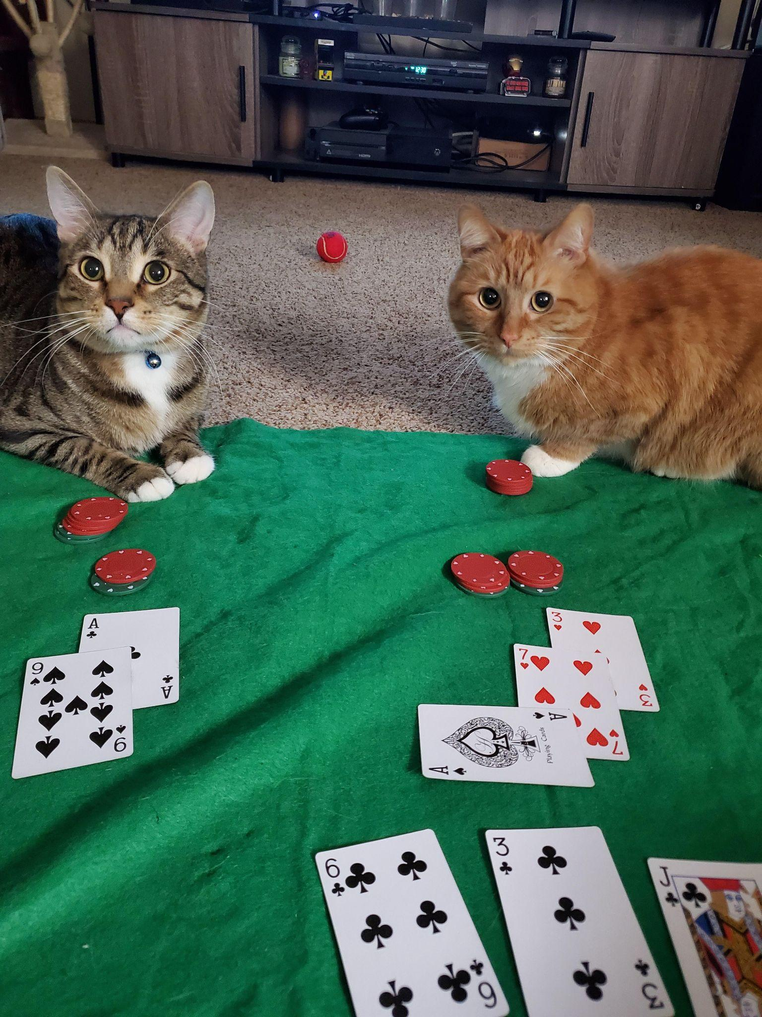
What is Blackjack?
Game of chance
Win by having a hand close to 21 or 21 but not over
Gameplay: Player and dealer is dealt 2 cards and player must decide to hit or stand.

Slide 3
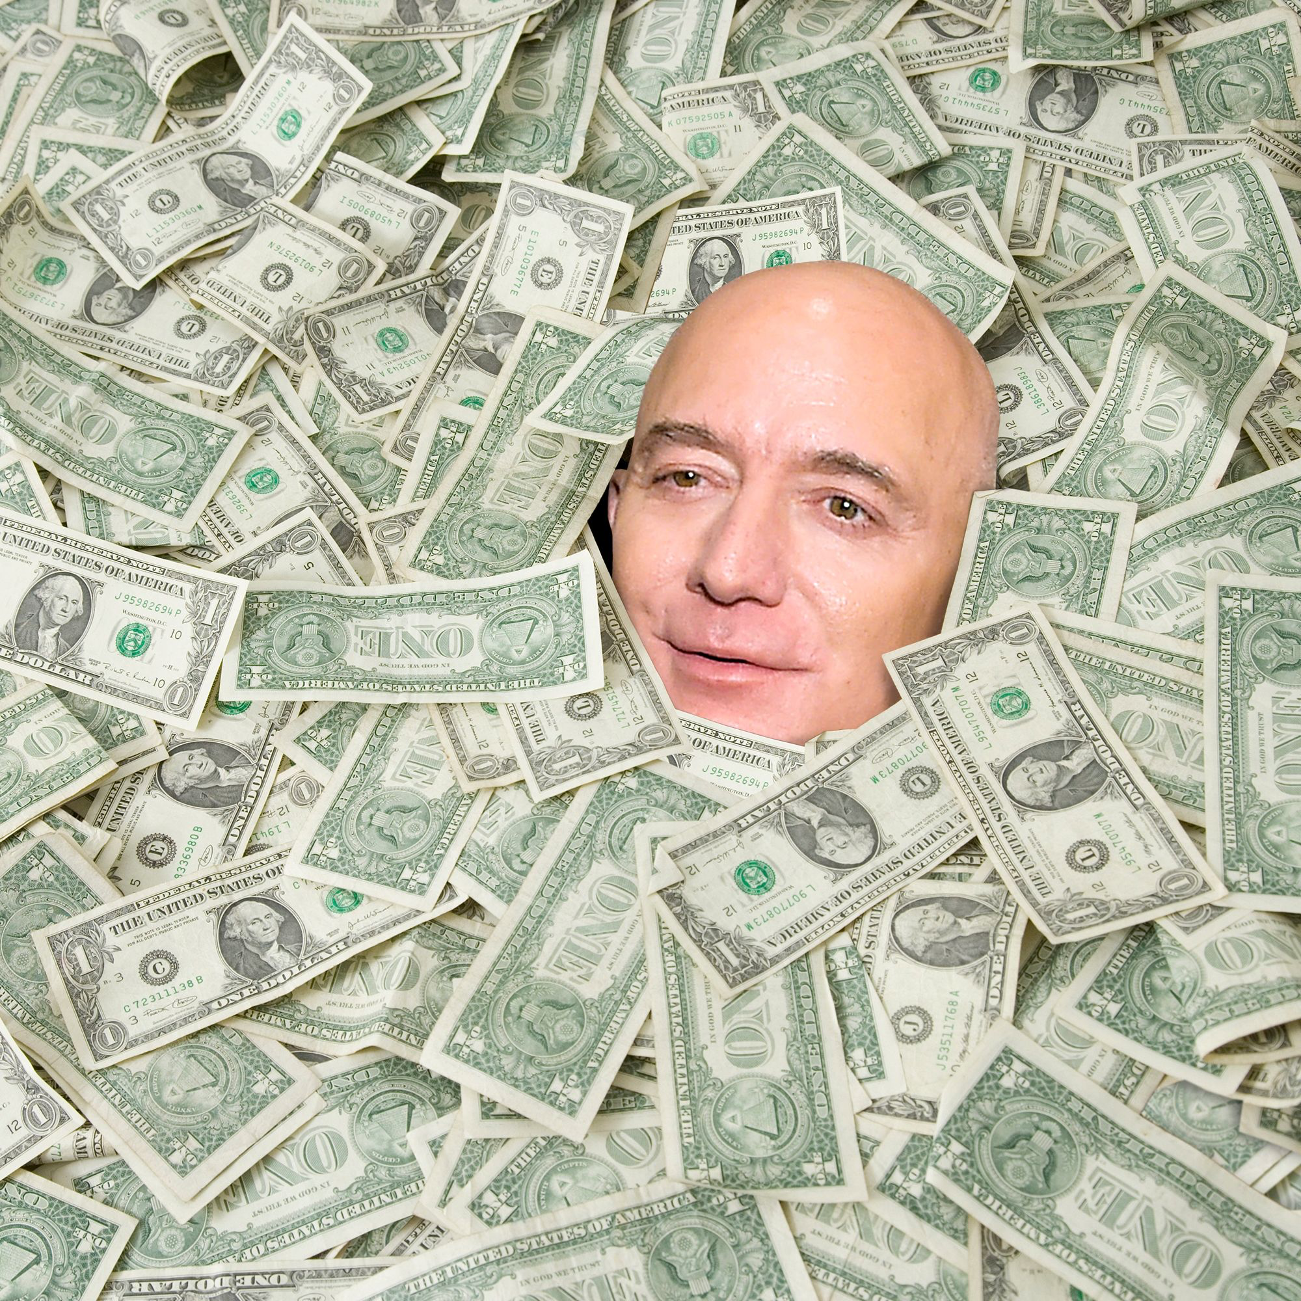
Tester: GETS a very, very attractive
20 sek (cash) compensation

Slide 4
Challenges we faced
… There were a few!

Slide 5
Challenges in planning
The simple complexities of Blackjack
Do we want to show strings J, Q, K, A for integers 10 and 11?
Split and double down functions?
Bank?
Some functions too simple…?
Too many functions that did one thing

Slide 6
Breaks… So many breaks!
Many possibilities when the game could stop
Blackjack or bust for both the player and dealer turns
Turns are while loops that need to be broken
Many if statements created many indents and many breaks
Very difficult to keep track of when fixing bugs

Slide 7

Scientific Method:
Trial and Error
When we could not understand why our code was working or when it was not working.
Try to break the game to find flaws.

Slide 8
Gamblers blues
Testing a game of chance means testing ALL outcomes
Some outcomes happen often
Some outcomes happen rarely
Some outcomes happen almost never
Still not sure if there is a bug somehow somewhere…

Slide 9
Highlights

Slide 10
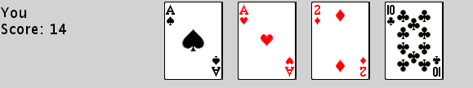
Ace function
Worked really well from the beginning
We initially had another plan : -10 from hand but…
Good logic since we consider index position

Slide 11
Drawing cards from deck
Function worked well from the beginning
Utilized list logic to remove each drawn card from the deck
Meaning yes, you could count cards… But not really.

Slide 12
Rewriting the logic
Rare bugs in our second version made us rewrite the code
Used almost the “same” logic but with simplified functions
… Failsafes included!
Easier to read, easier to understand, easier to bugfix and easier to add more functions and logic

Slide 13
Improvements in future developments
The simple complexities of Blackjack
Add ability to split and double
More than one player?
Variables and inputs
Transfer credits across games and ability to add more
Able to enter string into integer inputs
“Realistic” card draw and persistent deck
Cheat easter egg!

